Slide 1
LAN Connections
Understanding Binary Basics

Slide 2
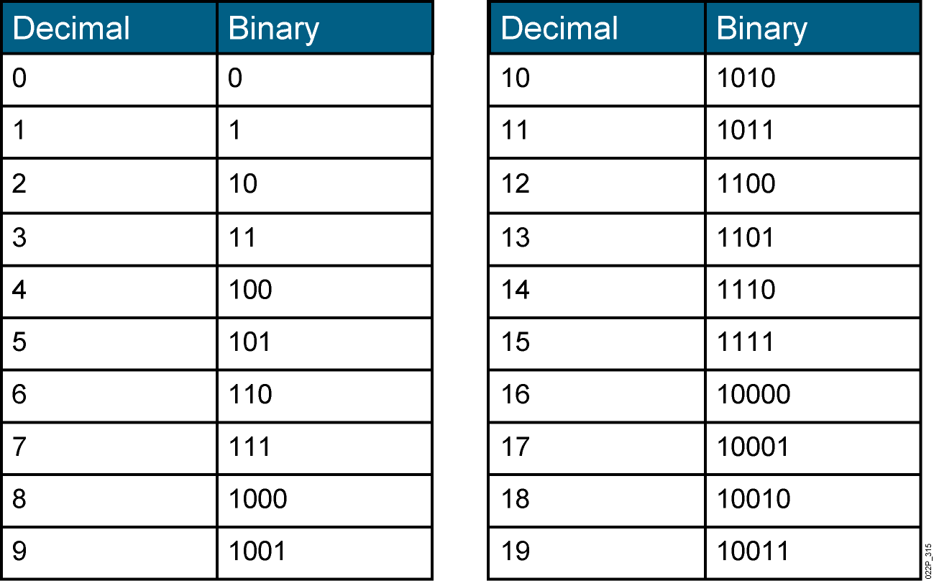
Decimal vs. Binary Numbers
  Decimal numbers are represented by the numbers 0 through 9.
  Binary numbers are represented by a series of 1s and 0s.
Notes:
Lesson Aim
<Enter lesson aim here.>

Slide 3
Decimal and Binary Numbers Chart
Base-10 Decimal Conversion—63204829
 | MSB |  |  |  |  |  |  | LSB
Base^{exponent} | 10⁷ | 10⁶ | 10⁵ | 10⁴ | 10³ | 10² | 10¹ | 10⁰
Column Value | 6 | 3 | 2 | 0 | 4 | 8 | 2 | 9
Decimal Weight | 10000000 | 1000000 | 100000 | 10000 | 1000 | 100 | 10 | 1
Column Weight | 60000000 | 3000000 | 200000 | 0 | 4000 | 800 | 20 | 9
60000000 + 3000000 + 200000 + 0 + 4000 + 800 + 20 + 9 = 63204829
Base-2 Binary Conversion—1110100 (233)
 | MSB |  |  |  |  |  |  | LSB
Base^{exponent} | 2⁷ | 2⁶ | 2⁵ | 2⁴ | 2³ | 2² | 2¹ | 2⁰
Column Value | 1 | 1 | 1 | 0 | 1 | 0 | 0 | 1
Decimal Weight | 128 | 64 | 32 | 16 | 8 | 4 | 2 | 1
Column Value | 128 | 64 | 32 | 0 | 8 | 0 | 0 | 1
128 + 64 + 32 + 0 + 8 + 0 + 0 + 1 = 233

Slide 4
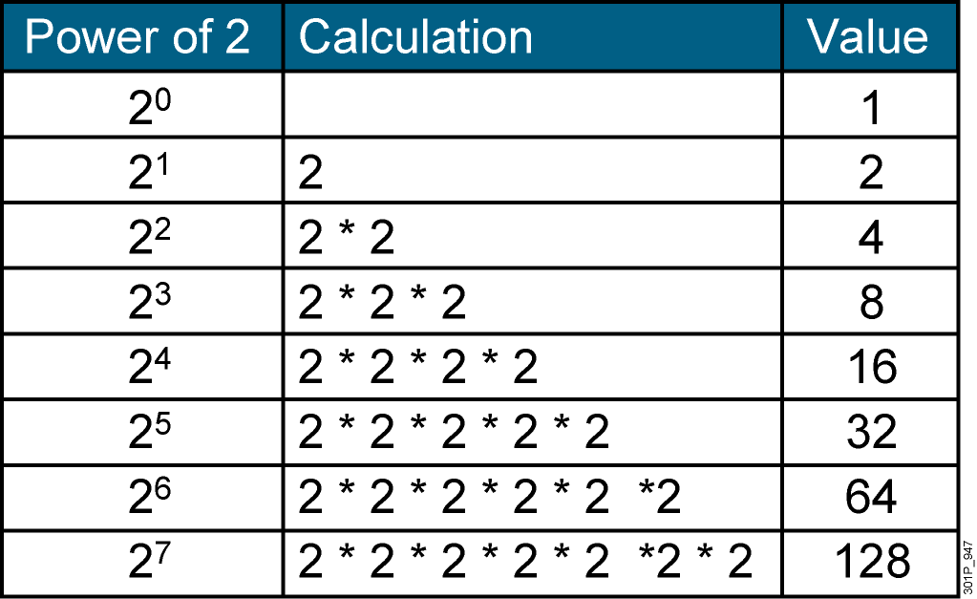
Powers of 2
Notes:
Lesson Aim
<Enter lesson aim here.>

Slide 5
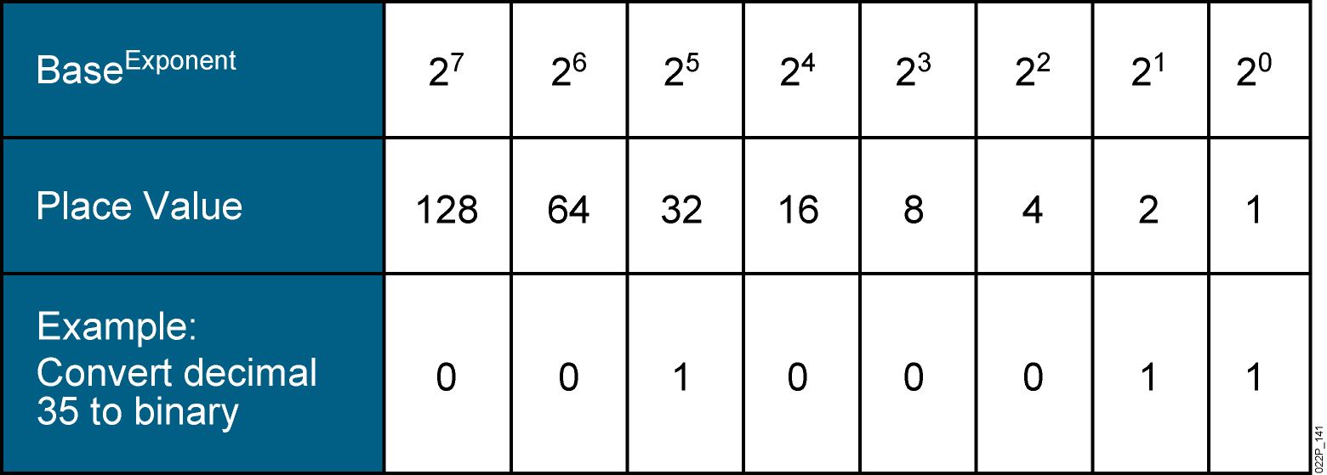
Decimal-to-Binary Conversion
35 = 2⁵ + 2¹ + 2⁰
35 = (32 * 1) + (2 * 1) + (1 * 1)
35 = 0 + 0 + 1 + 0 + 0 + 0 + 1 + 1
35 = 00100011

Slide 6
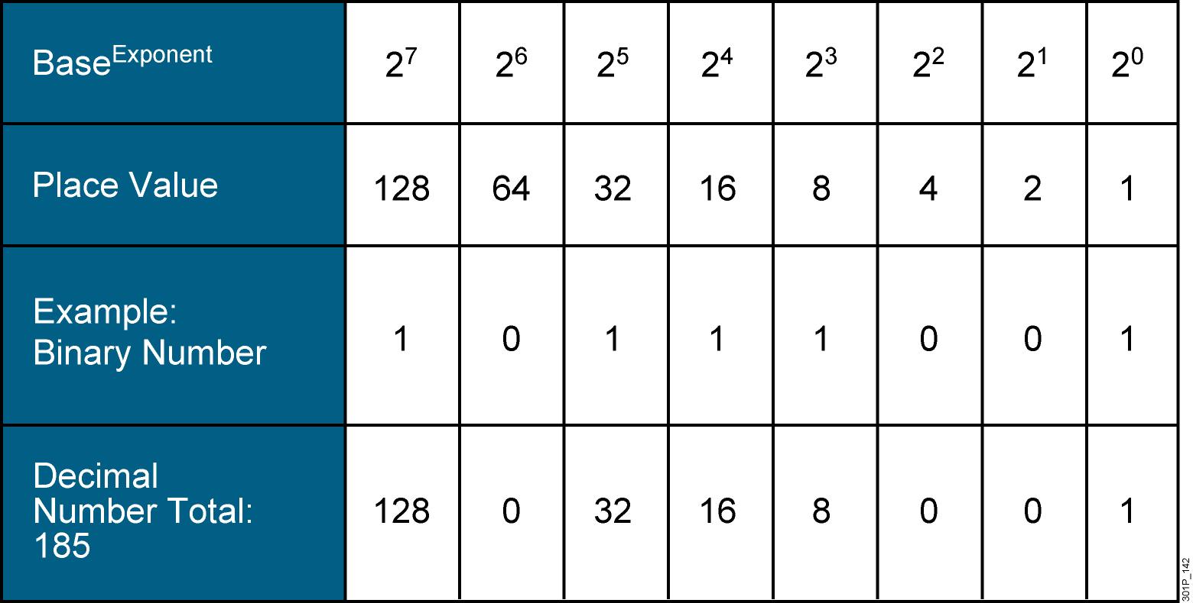
Binary-to-Decimal Conversion
1 0 1 1 1 0 0 1 = (128 * 1) + (64 * 0) + (32 * 1) + (16 * 1) + (8 * 1) + (4 * 0) + (2 * 0) + (1 * 1)
1 0 1 1 1 0 0 1 = 128 + 0 + 32 + 16 + 8 + 0 + 0 + 1
1 0 1 1 1 0 0 1 = 185

Slide 7
Summary
  All computers operate using a binary system.
  Binary systems (base 2) use only the numerals 0 and 1.
  Decimal systems (base 10) use the numerals 0 through 9.
  Using the powers of 2, a binary number can be converted into a decimal number.
  Using the powers of 2, a decimal number can be converted into a binary number.

